Slide 1
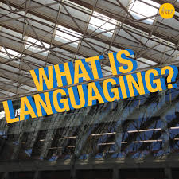
Research discussions 7th December 2020 Richard Watson Todd

Slide 2
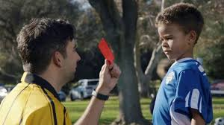
Hobby Course
Wikipedia course
Traditional ELT
Why do we teach English?
How can we motivate students?

Slide 3
The languaging curriculum
Learning to strategically make use
of available tools
and resources
to successfully do things in English for real-world purposes

Slide 4
Theoretical foundations
Languaging
English as a Lingua Franca (2nd stage)
Experiential learning
Learning that you can do things
Learning how to do things
Learning through doing things

Slide 5
Shifts in perspective about the norms for language teaching
Before 1950 | Integrative purposes | To access NS culture | High-formality NS norms
1950s-2000s | Instrumental purposes | To use language with NSs | Standard NS norms
2000s on | Instrumental purposes | To use language with other high-level speakers | Standard NS norms + exposure to World Englishes
2010 on | Instrumental purposes | To use language with others | Questioning NS norms; context-specific norms
2020 | Instrumental purposes | To use language to do things | No norms or context-specific norms

Slide 6
The languaging curriculum
Focus on doing things with English
Focus on success
Focus on process
Be non-judgmental
Language use strategies
Real-world use
Focus on the English language itself
Focus on accuracy
Focus on product
Correct mistakes
Language forms
Classroom practice

Slide 7
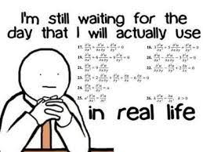
Why use the languaging curriculum?

Slide 8
The languaging curriculum
Language use strategies e.g. analyzing texts to identify useful phrases
Google Translate
Learning to strategically make us of available tools and resources to successfully do things in English for real-world purposes
Existing model texts
Communicate online about your interests

Slide 9
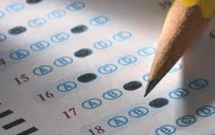
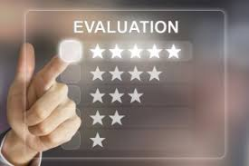
Challenges with languaging

Slide 10
Languaging in practice
LNG105/221 Hobby Course
LNG106/222 Survey
LNG107/321 Wikipedia
Article accepted for ELTJ
Article accepted for book
Languaging is a new paradigm in ELT
Using languaging can promote SoLA
Make plans for further external promotion

