Slide 1
How is English assessed at Thai schools?
Richard Watson Todd
King Mongkut’s University of Technology Thonburi

Slide 2
“The consequences of testing and grading students are immense. They can determine the colleges students attend, the careers open to them, and the lifestyles they ultimately maintain.”
Arends, 2007: 247

Slide 3
Assessment in Thailand
National Education Act of 1999, Section 26
“Educational institutions shall assess learners’ performance through observation of their development; personal conduct; learning behaviour; participation in activities and results of the tests accompanying the teaching–learning process commensurate with the different levels and types of education.”
Key issue: use of multiple methods of assessment

Slide 4
Purposes of assessment in Thailand
Basic Education Core Curriculum 2008
Informing students of their progress
Using results as information for improvement and development
Using results as information for study plans and career choices
Issuing documents about educational qualifications
Informing authorities to aid in developing policies

Slide 5
Purposes of assessment in Thailand
UNESCO 2016
Informing decisions about student retention and promotion, and grouping students
Comparing individual schools against other schools or national standards
Monitoring schools’ progress
Making judgments about teachers’ effectiveness
Identifying areas of the curriculum to improve

Slide 6
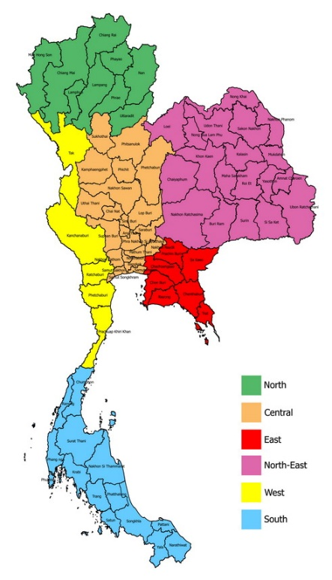
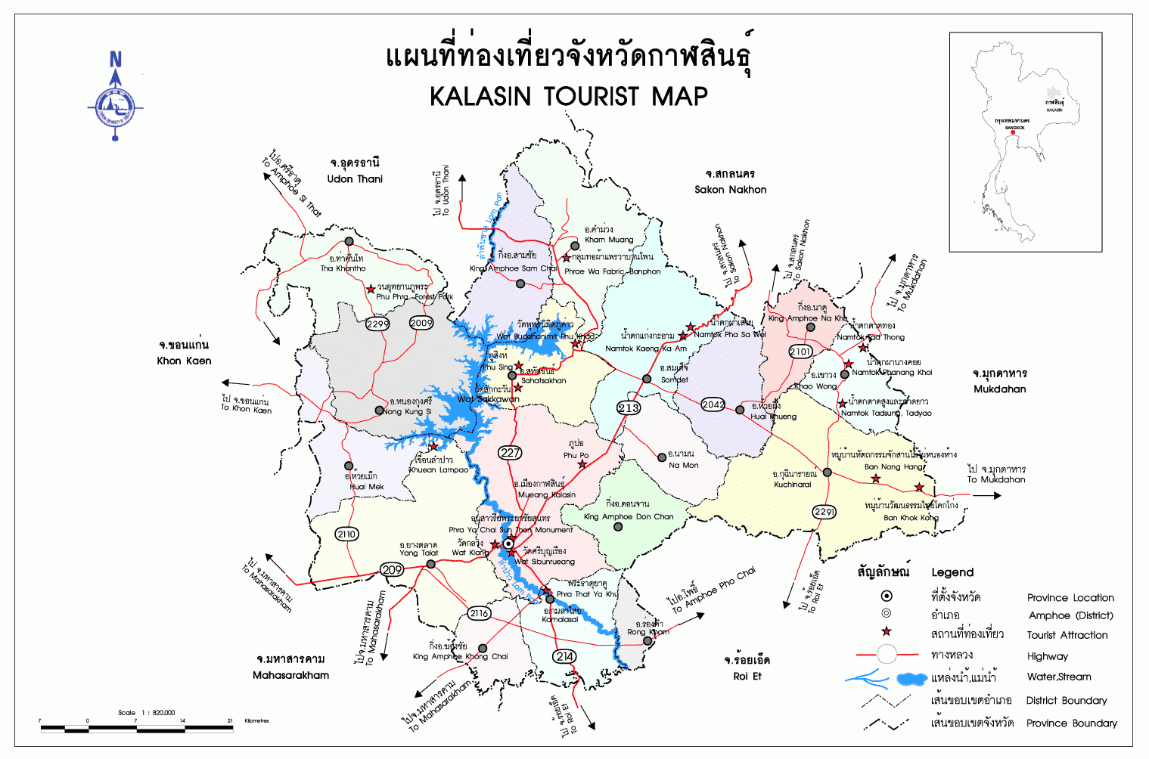
Levels of assessment in Thailand
Basic Education Core Curriculum 2008
National-level
District-level
School-level
Classroom-level

Slide 7
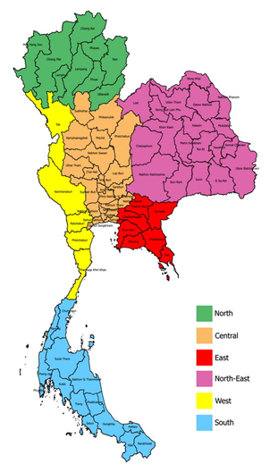
Types of assessment in Thailand
Basic Education Core Curriculum 2008
National-level

Slide 8
National assessment in Thailand
ONET
Multiple-choice

Slide 9
Washback from ONET
Effects of assessment on other aspects of education
Effects on teaching, how students learn, attitudes towards knowledge etc.
Positive washback – beneficial for education
Negative washback – detrimental to education
In Thailand, most washback is negative (UNESCO, 2016)

Slide 10
Washback from multiple-choice
Schools use ONET as a model for their tests
Teaching focuses on vocabulary and grammar
Emphasis is on receptive skills
Rote learning is promoted
Little use of higher-order thinking
The focus is on simplistic, non-transferable knowledge
Students are encouraged to be knowledge seekers, not understanding seekers

Slide 11
Evidence of problems from multiple-choice
Too many multiple choice item tests as teachers do not have the time to grade essays or implement continuous assessment (Chulalongkorn University, 2000)

Slide 12
Evidence of problems from multiple-choice
Too many multiple choice item tests as teachers do not have the time to grade essays or implement continuous assessment (Chulalongkorn University, 2000)
Influence of ONET as the most serious problem secondary school teachers face – more serious than class size, overwork, lack of community support, students’ low ability (Thongsri et al., 2006)
62% of students want more varied item types in how they are assessed (Jaturapitakkul, 2013)

Slide 13
What needs to be done
UNESCO, 2016
“move beyond the traditional modes of assessment, which have often tended to focus on the reproduction of discrete knowledge, and shift towards a broad mix of assessments that measure – and thus value – the application of knowledge and the development of a broad set of skills”
“Thailand needs to ensure that students are being assessed in the classroom in ways that contribute actively towards their learning. Overreliance on summative testing – in particular, on high-stakes testing linked to national examinations – needs to give way to a strategy that expressly supports the innovative use of formative assessment techniques.”

Slide 14
What needs to be done
UNESCO, 2016
“move beyond the traditional modes of assessment, which have often tended to focus on the reproduction of discrete knowledge, and shift towards a broad mix of assessments that measure – and thus value – the application of knowledge and the development of a broad set of skills”
“Thailand needs to ensure that students are being assessed in the classroom in ways that contribute actively towards their learning. Overreliance on summative testing – in particular, on high-stakes testing linked to national examinations – needs to give way to a strategy that expressly supports the innovative use of formative assessment techniques.”

Slide 15
What needs to be done
Assessment is important
Multiple methods should be used
Assessment serves multiple purposes
Washback from national exams and multiple-choice testing has negative effects
Need more assessment of skills and formative assessment
Need to know how English is assessed at schools

Slide 16
How was English assessed at Thai schools?
Piboonkanarax (2007)
Responses from 78 schools
Exams (final, mid-term, quizzes) 59%
Continuous assessment 41%
Most frequent item type on exams: Multiple-choice

Slide 17
How is English assessed at Thai schools?
Online survey of English teachers at Thai schools
Self-selection for respondents
347 responses
320 usable responses

Slide 18
How is English assessed at Thai schools?

Slide 19
How is English assessed at Thai schools?
Most frequently used types of assessment
Assessment type | % of teachers who use it
Final exam | 100
Mid-term exam | 92
Quizzes | 91
Participation | 87
Homework | 86
Presentations | 85
Portfolios | 77
Reports/projects | 75

Slide 20
How is English assessed at Thai schools?
Types of assessment accounting for at least 15% of overall score (for those teachers who use them)
Final exam
Quizzes
Mid-term exam
Reports/projects

Slide 21
Openness of English assessment at Thai schools

Slide 22
Assessment by school level Using point biserial correlation to compare values
Primary schools
Use more mid-term exams
Use more multiple-choice
Secondary schools
Use more continuous assessment
Use more open-ended items

Slide 23
Assessment by location Using point biserial correlation to compare values
Bangkok schools
Use more exams
Upcountry schools
Use more continuous assessment

Slide 24
Does the assessment fit with the National Education Act?
Learners shall be assessed through:
Observation of development | ✗
Personal conduct | ?
Learning behavior | ?
Participation in activities | ✓
Results of tests | ✓

Slide 25
Does the assessment fit the purposes of the Basic Education Core Curriculum?
The purposes of assessment are
Informing students of progress | ?
Information for development | ✗
Setting study plans | ✗
Issuing qualifications | ✓
Developing policies | ?

Slide 26
Does the assessment fit the purposes identified by UNESCO?
The purposes of assessment are
Student retention and promotion | ✓
Comparing schools | ✓
Monitoring school progress | ✗
Judging teacher effectiveness | ?
Improving the curriculum | ✗

Slide 27
Does the assessment promote negative washback?
Aspects of negative washback
Emphasis on receptive skills | ?
Little higher-order thinking | ✓
Focus on knowledge | ?

Slide 28
Does the assessment meet the UNESCO ‘to do list’?
Directions for changing assessment
Reduced emphasis on knowledge tests | ✗
Assessment of broader range of skills | ?
Less reliance on summative testing | ?
Innovative use of formative assessment | ?

Slide 29
How is English assessed in Thai schools?
Final exams account for only a quarter of all marks
Exams and quizzes account for the majority of marks
Controlled items account for the majority of marks
Most teachers use some open-ended continuous assessment
Some innovative practices, especially at upcountry secondary schools, can act as models for the future

