Slide 1
The hobby course
LNG221

Slide 2
“
“The hobby course values learners; it is about what the learners want and need, not what teachers want or need.”

Slide 3
The key concept
Students are able to do ‘things’ in English.
Source: Google Images

Slide 4
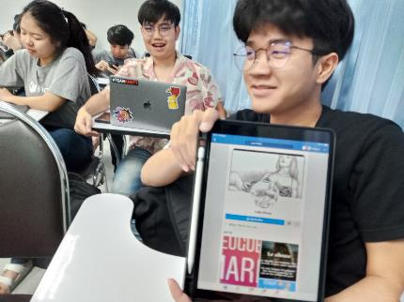
Learning to make use of resources to do the hobby
Creating a video on the hobby
Interacting about the hobby

Slide 5
Course structure
Overview | Details
Identifying a hobby | Exploring choices of hobby / hobby criteria
Learning the hobby | Identifying resources to do the hobby / analyzing resources
Interacting about the hobby | Analyzing Reddit questions and forum interaction / Posting and interacting on the forum
Creating a video on the hobby | Analyzing existing videos / designing videos / Posting videos
Summary | Wrap up / reflections on learning

Slide 6
Course assessment
Tasks | Description
Reading sources evaluation | Students select 5 readings relevant to their hobby. They then evaluate the selected resources based on certain issues.
Video sources evaluation | Students select 5 videos relevant to their hobby. They then evaluate the selected resources based on certain issues.
Interactions on Reddit and short report | Students make contributions on Reddit (posts + comments) and write a short reflection
Learning reflection (1st) | Students write a reflection in the first half of the course.
Learning reflection (2nd) | Students write a reflection in the second half of the course.
Video | Students create a video of themselves demonstrating their hobby.

Slide 7
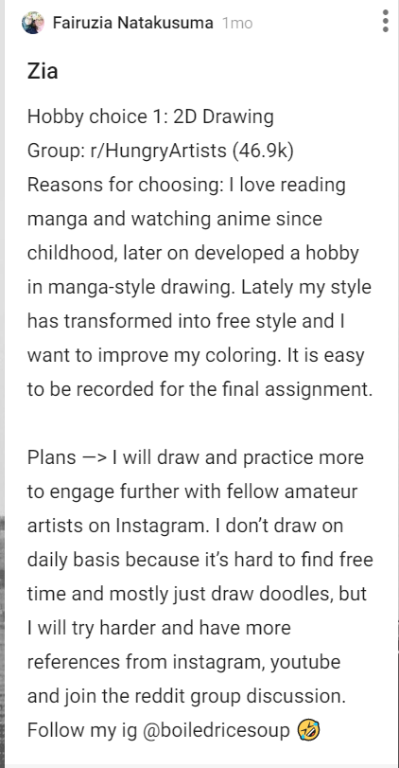
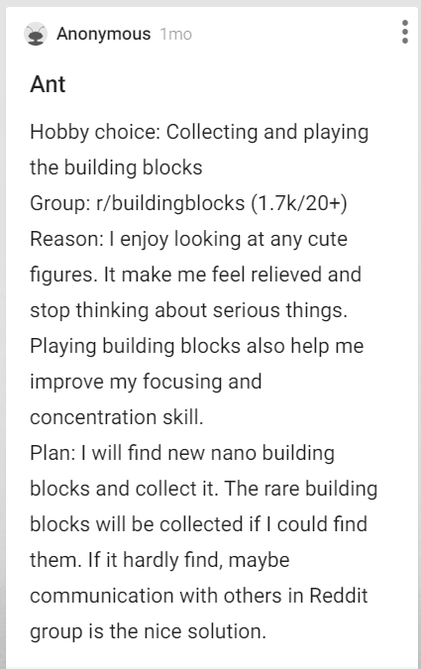
Identifying a hobby

Slide 8
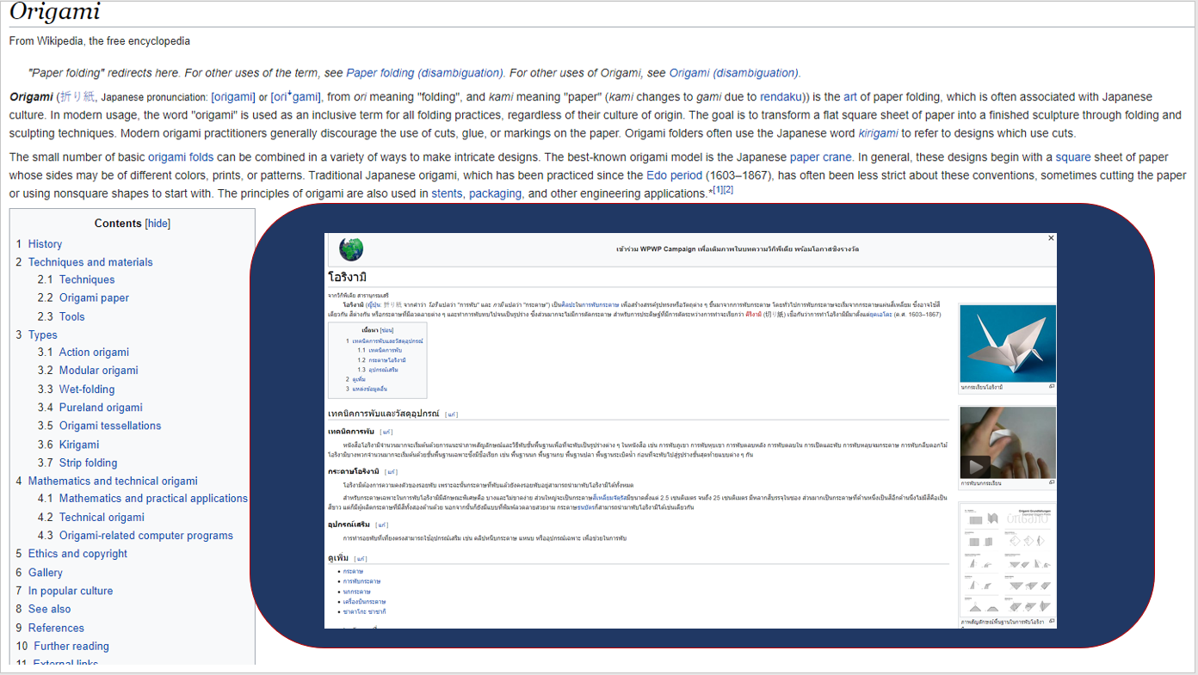
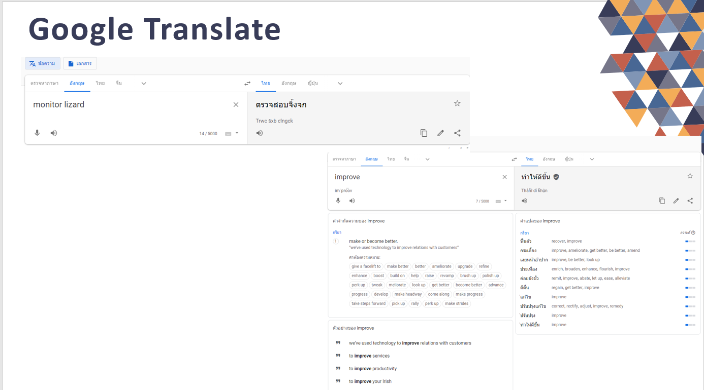
Learning the hobby

Slide 9
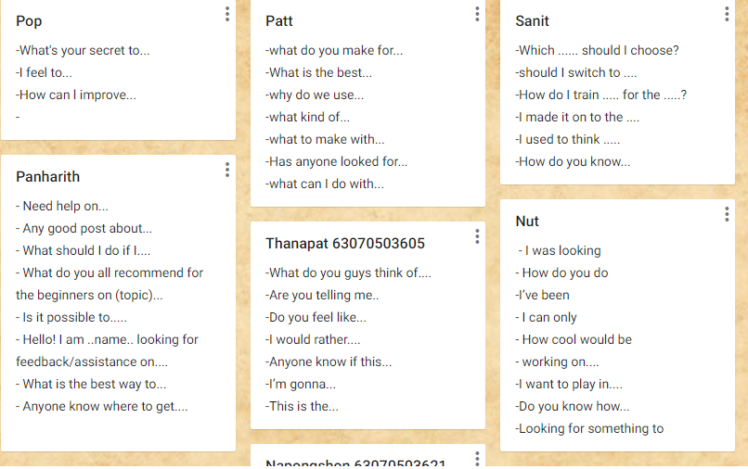
Interacting about the hobby

Slide 11
Issues regarding students’ expectation of English language learning

Slide 13
Reddit

Slide 14
Google Translate

