Slide 1
Corpus processing tools
Punjaporn Pojanapunya February 26, 2018
punjaporn.poj@mail.kmutt.ac.th

Slide 2
Corpora & Corpus tools
BNC, COCA, MICASE, DIY corpus
AntConc, KeyBNC, WordSmith, Wmatrix
TagAnt, CLAWS, USAS
Google Books Ngram Viewer
AntWordProfiler, Range
Word frequency lists concordances collocations clusters keywords

Slide 3
BNC, COCA, MICASE, DIY
Part i: corpora

Slide 4
A corpus
“A corpus can be defined as a collection of texts assumed to be representative of a given language put together so that it can be used for linguistic analysis. Usually the assumption is that the language stored in a corpus is naturally-occurring, that is gathered according to explicit design criteria, with a specific purpose in mind, and with a claim to represent natural chunks of language selected according to specific typology.”
Tognini-Bonelli (2001:2)
“A corpus is a collection of (1) machine-readable (2) authentic texts (including transcripts of spoken data) which is (3) sampled to be (4) representative of a particular language or language variety.”
McEnery, Xiao and Tono (2006:5)

Slide 5
Some well-known existing corpora
The British National Corpus (BNC)
http://corpus.byu.edu/bnc/
Corpus of Contemporary American English (COCA)
http://corpus.byu.edu/coca/
The International Corpus of English (ICE)
http://www.ucl.ac.uk/english-usage/projects/ice.htm
Michigan Corpus of Academic Spoken English (MICASE)
http://quod.lib.umich.edu/m/micase/

Slide 6
https://corpus.byu.edu/

Slide 7
BNC, COCA, MICASE, DIY corpus
AntConc, KeyBNC, WordSmith, Wmatrix
TagAnt, CLAWS, Wmatrix-semantic tagger
Google Books Ngram Viewer
AntWordProfiler, Range(AWL, GSLs)
Part II: Corpus analysis tools

Slide 8
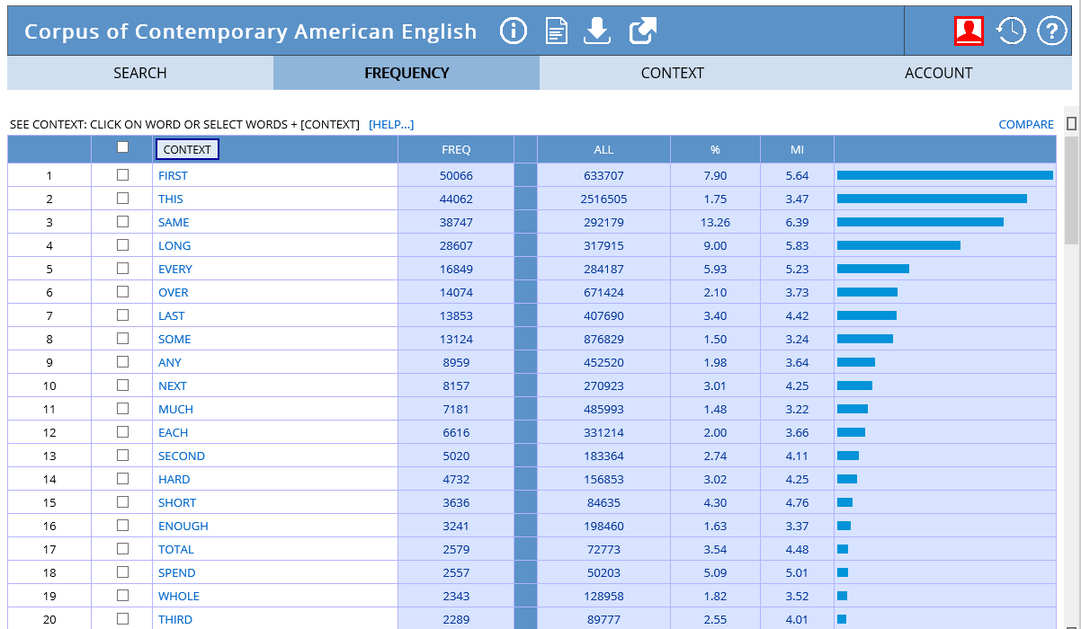
Corpus analysis tools
2
Existing corpora
Online (corpus + tools)
CD, DVD (corpus)
DIY corpora
1
Photo: https://www.corpusdata.org/intro.asp

Slide 9
COCA
Part II: Corpus analysis tools

Slide 10
Corpus of Contemporary American English (COCA)
560 M words of American English
20 million words per year 1990-2017
equally divided among spoken, fiction, popular magazines, newspapers, and academic texts
Useful for studying variation across genres and over time

Slide 11
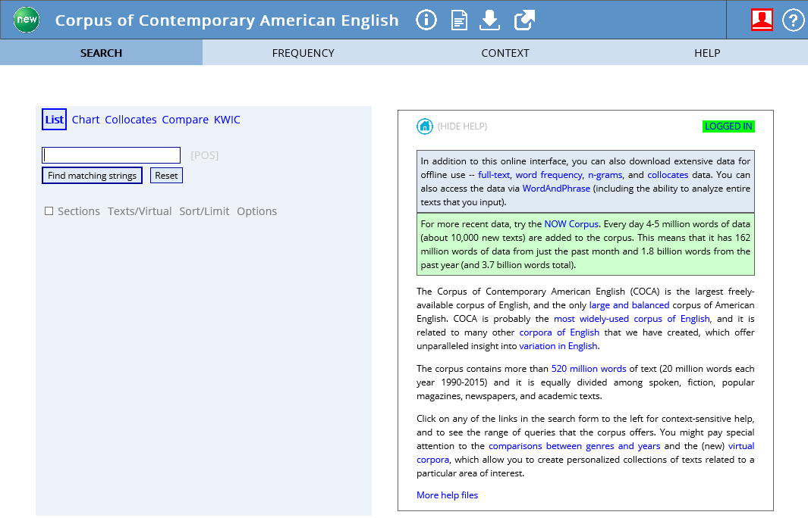
Searching COCA
https://corpus.byu.edu/coca/

Slide 12
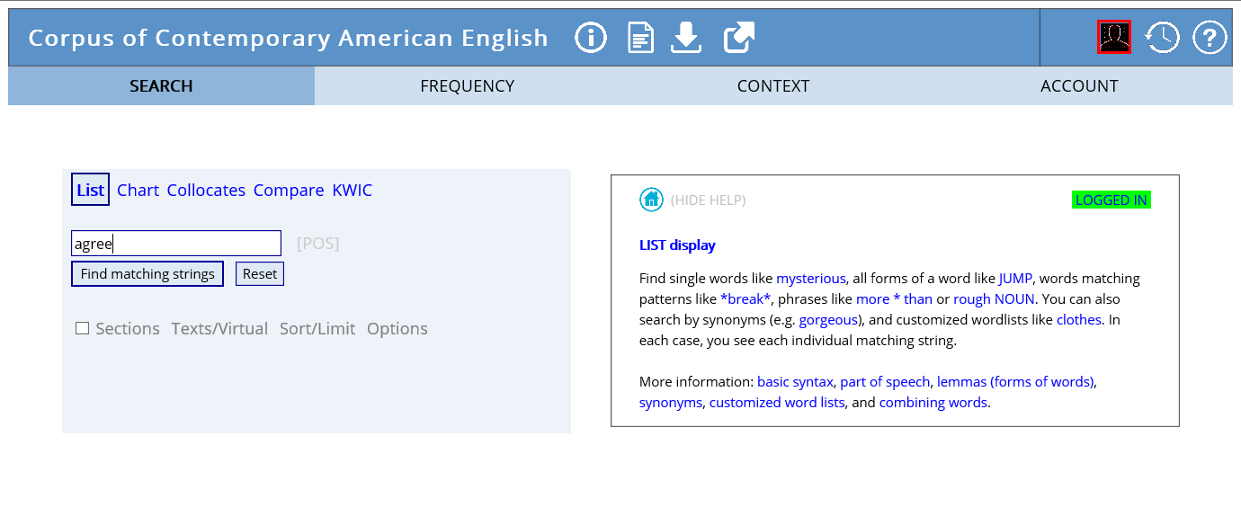

Slide 13
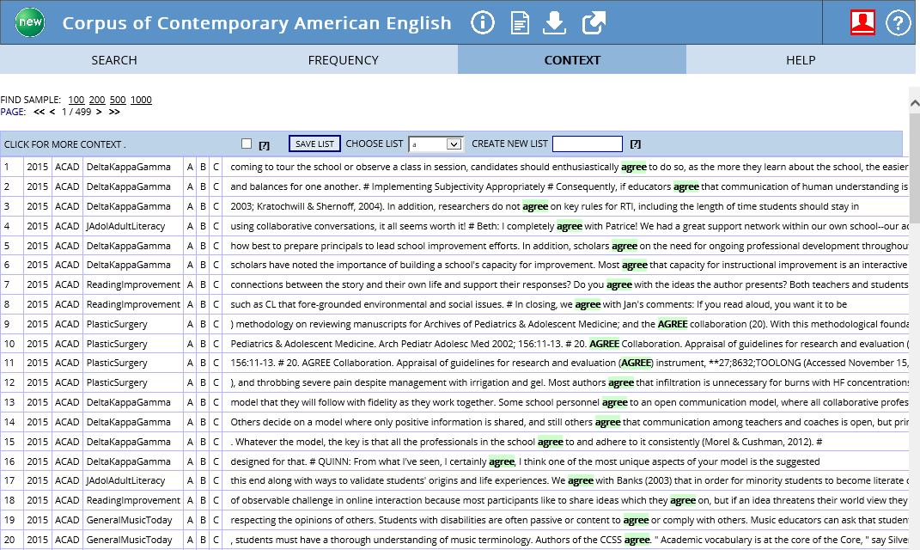

Slide 14
Searching COCA
Allows users to compare searches by:
Genre:
spoken, fiction, popular magazines, newspapers, and academic, or sub-genres e.g. movie scripts, sports magazines, newspaper editorial, or scientific journals
Time:
1990 to 2017

Slide 15
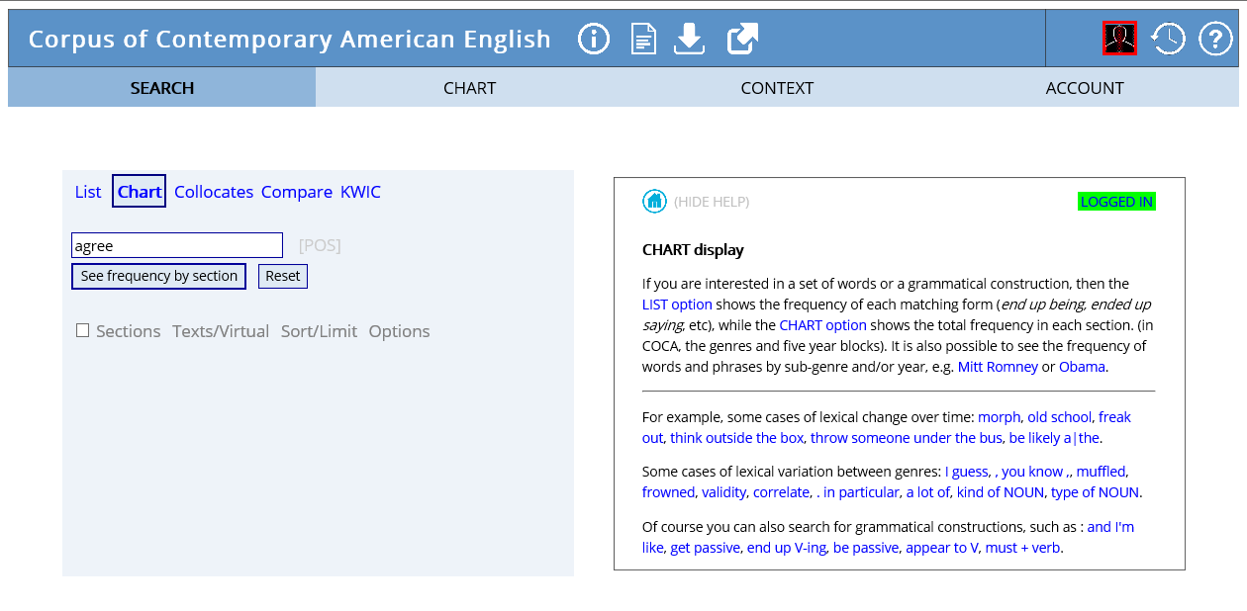

Slide 16
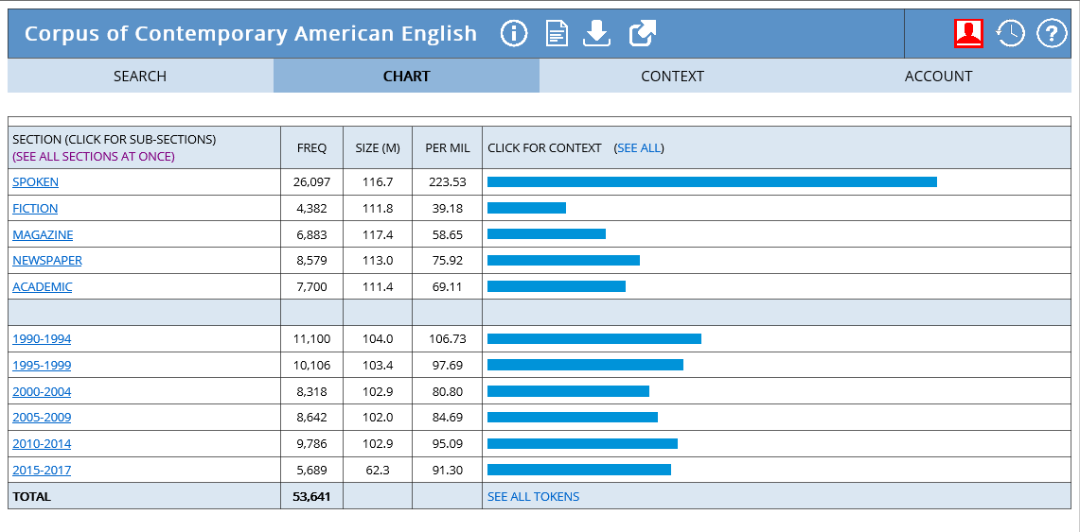
chart

Slide 17
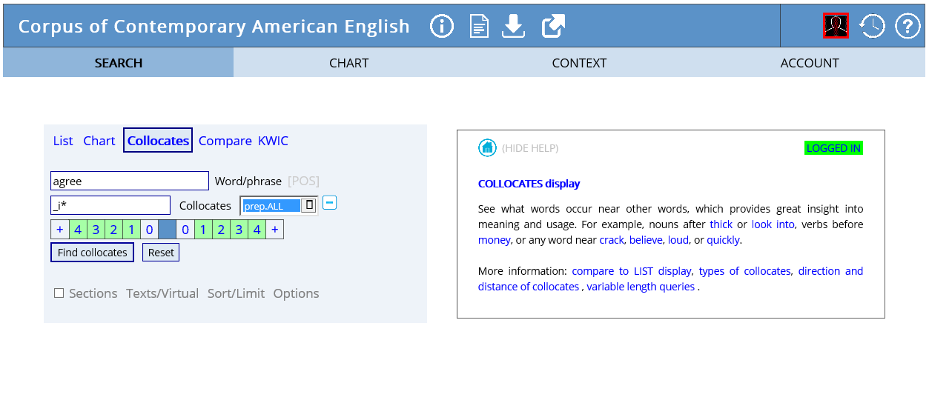

Slide 18
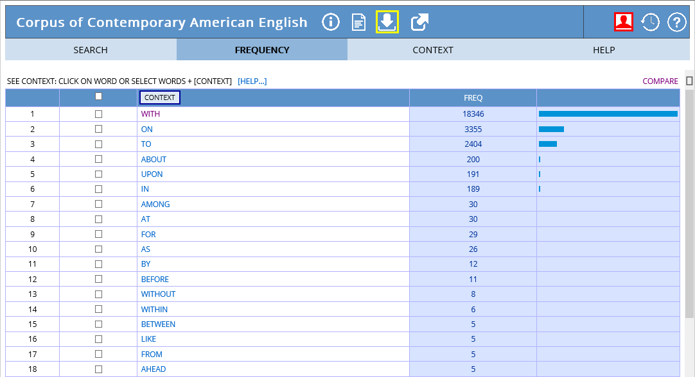
collocates

Slide 19
Searching COCA
Allows users to carry out semantically-based queries of the corpus
compare and contrast the collocates of two related words e.g. occur/happen, learn/study, men/women
determine the difference in meaning or use between words.
find the frequency and distribution of synonyms and compare different genres

Slide 20
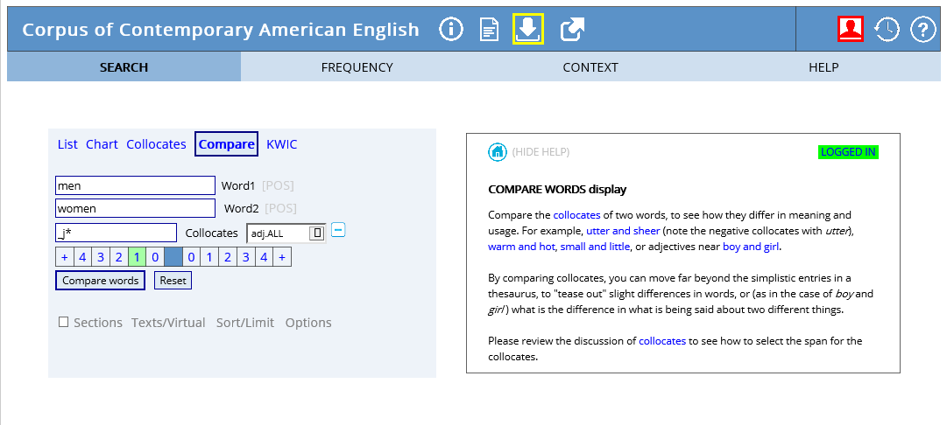
compare

Slide 21
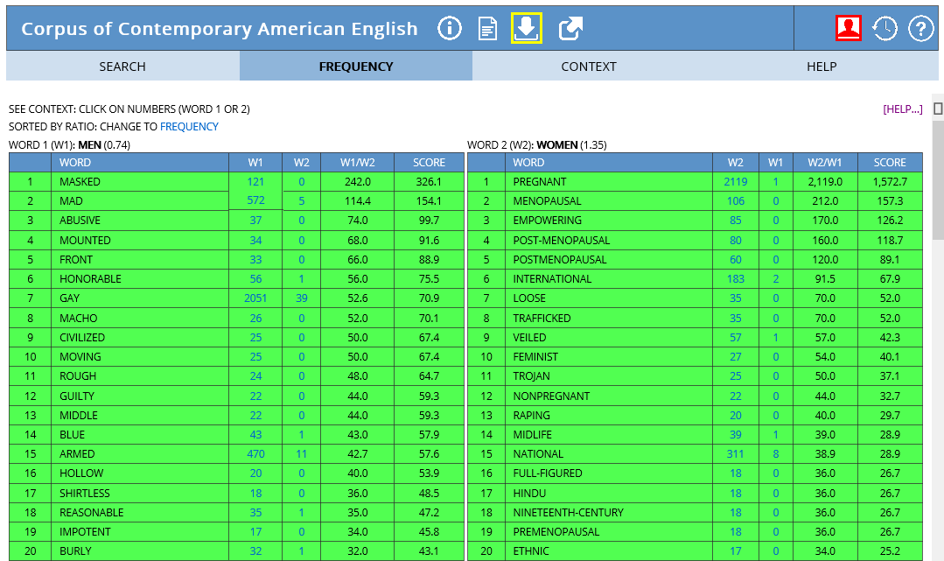

Slide 22
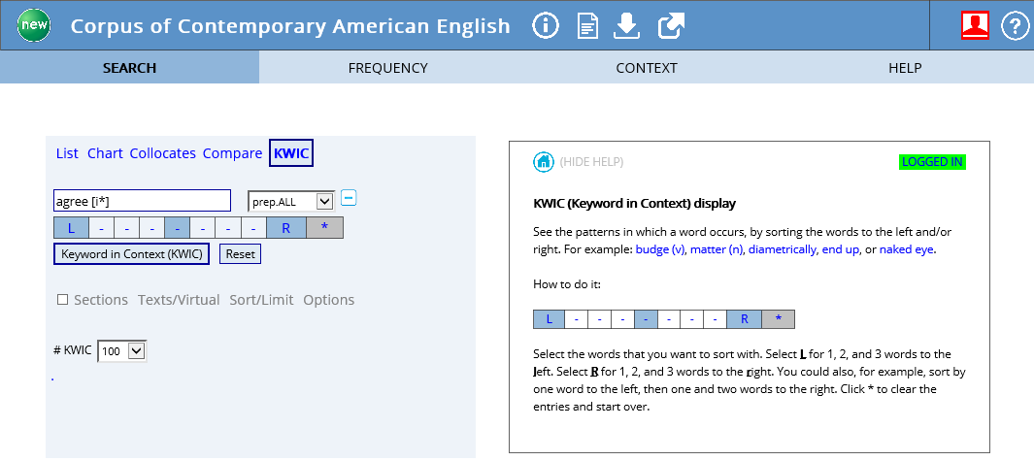

Slide 23
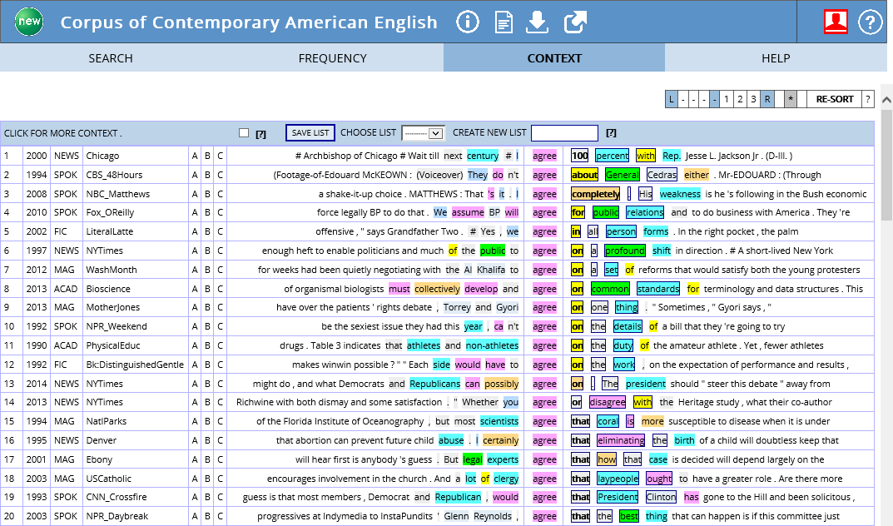

Slide 24
AntConc, KeyBNC, WordSmith, Wmatrix
Word frequency lists concordances collocations clusters keywords
Part II: Corpus analysis tools

Slide 25
Analyzing a DIY corpus
A corpus of specific genre of text
A corpus software tool
A tool allows users to search for target language features in a corpus.
AntConc, KeyBNC
Simple Concordance Program
WordSmith Tools
Wmatrix
2
1

Slide 27
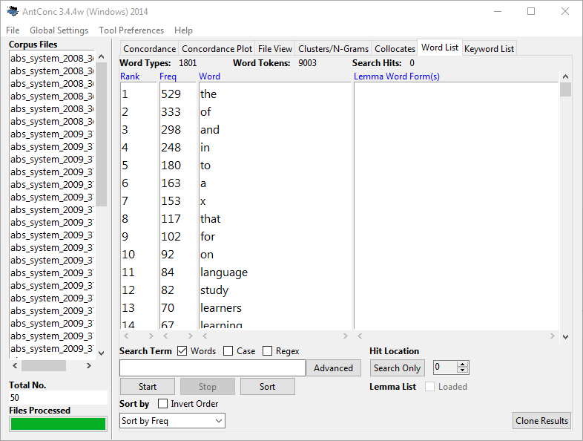

Slide 28
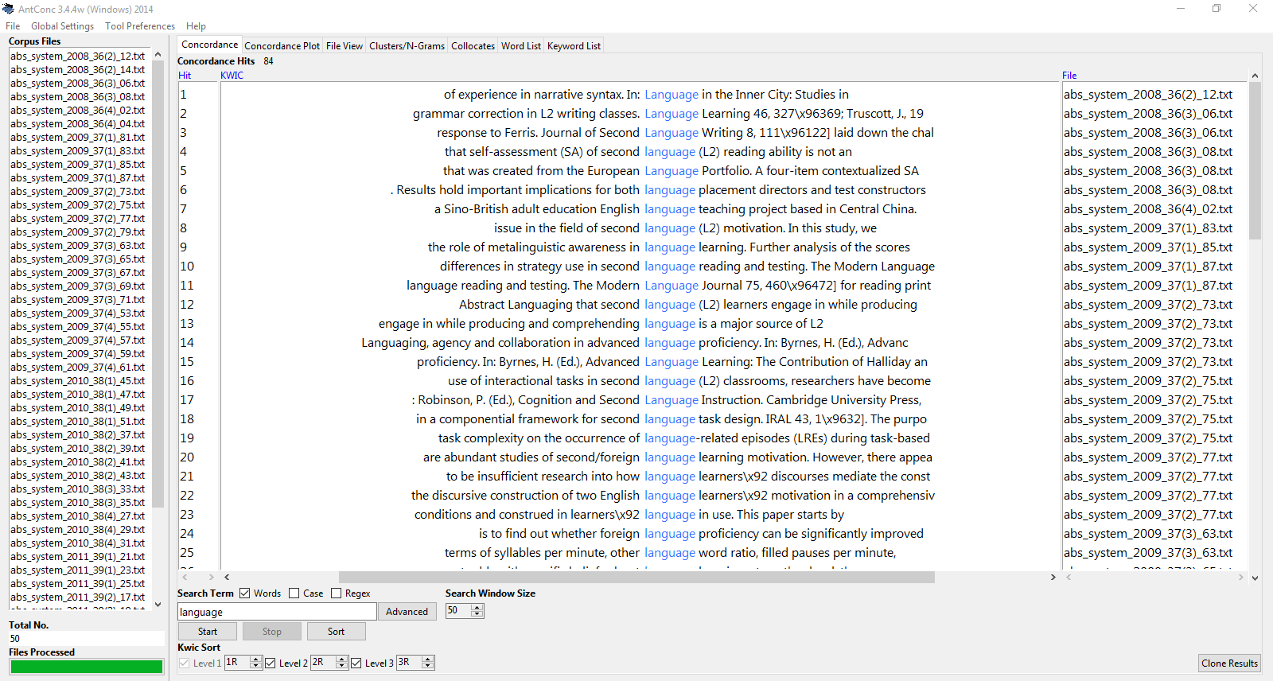

Slide 29
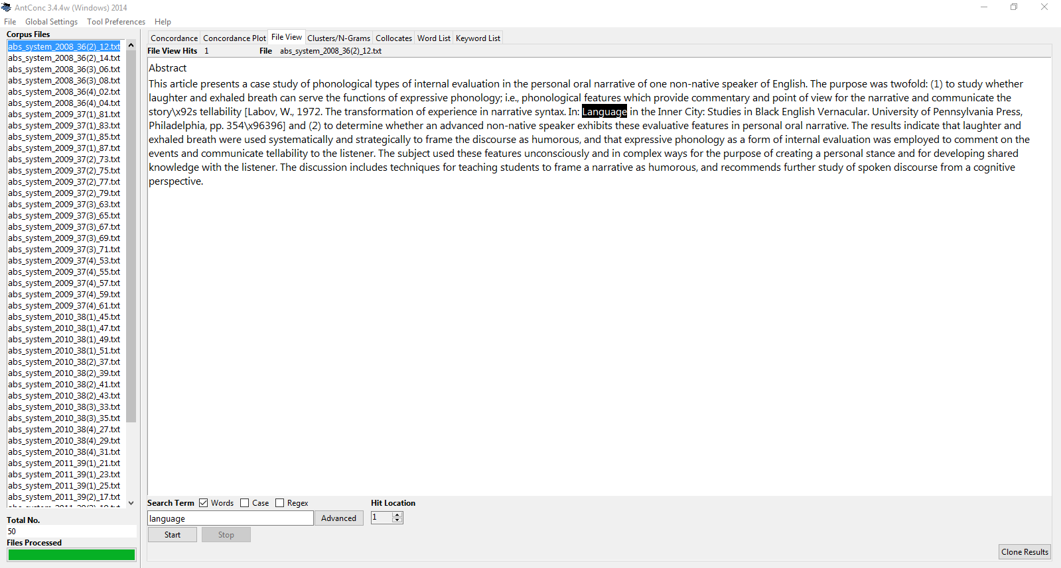

Slide 30
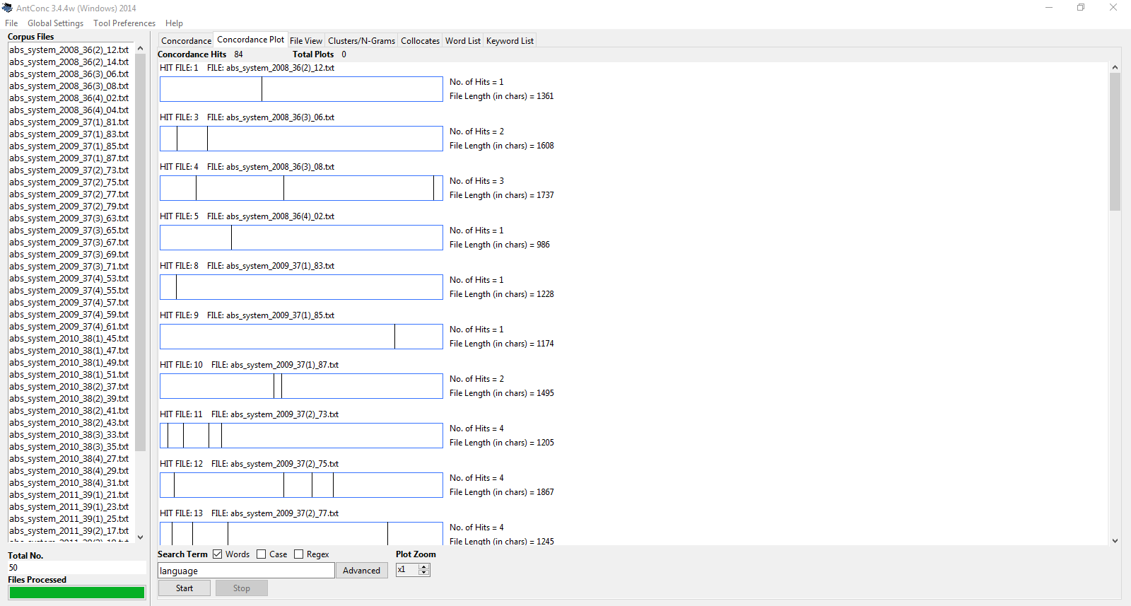

Slide 31
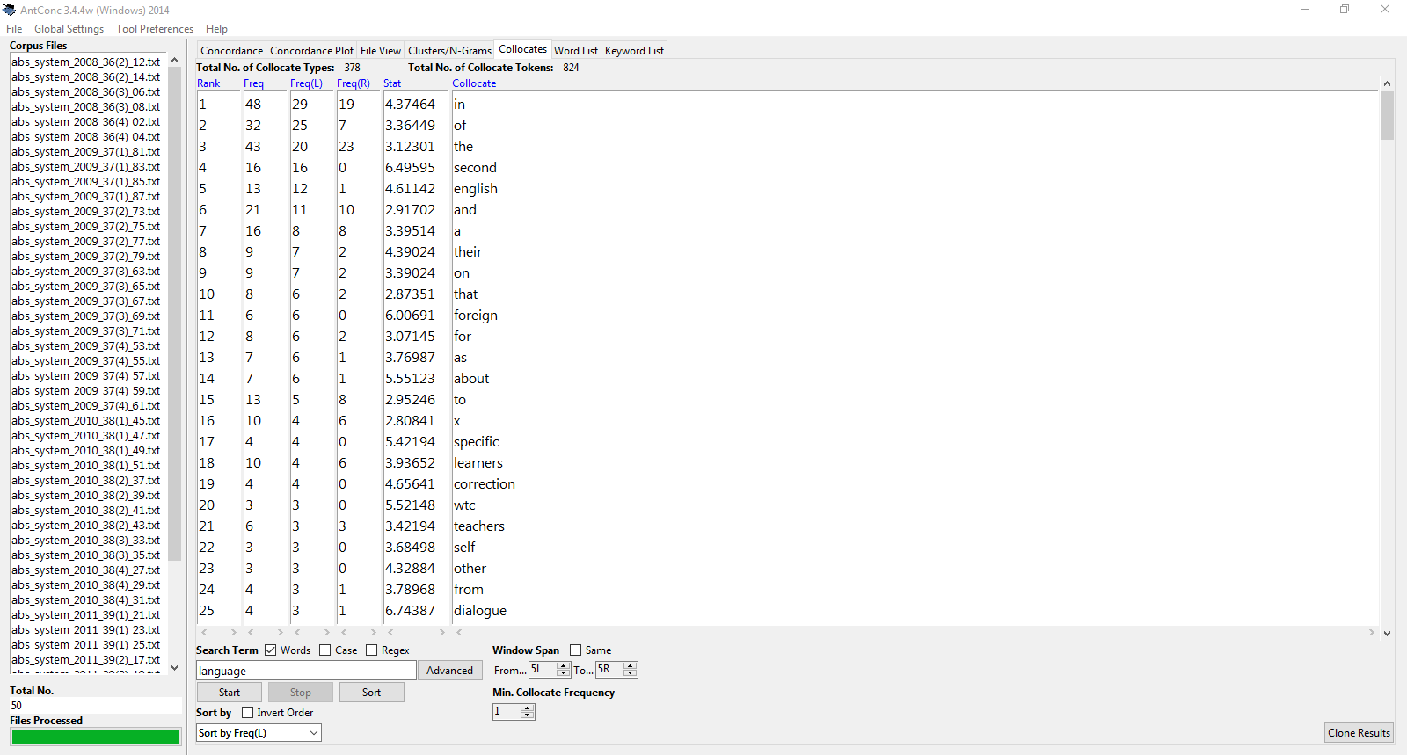

Slide 32
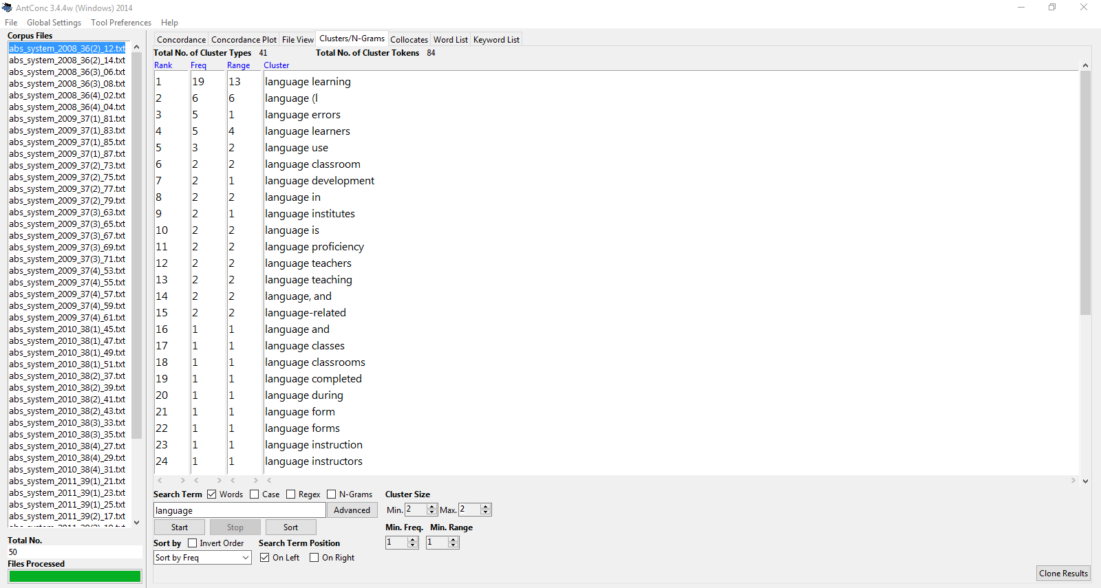

Slide 33
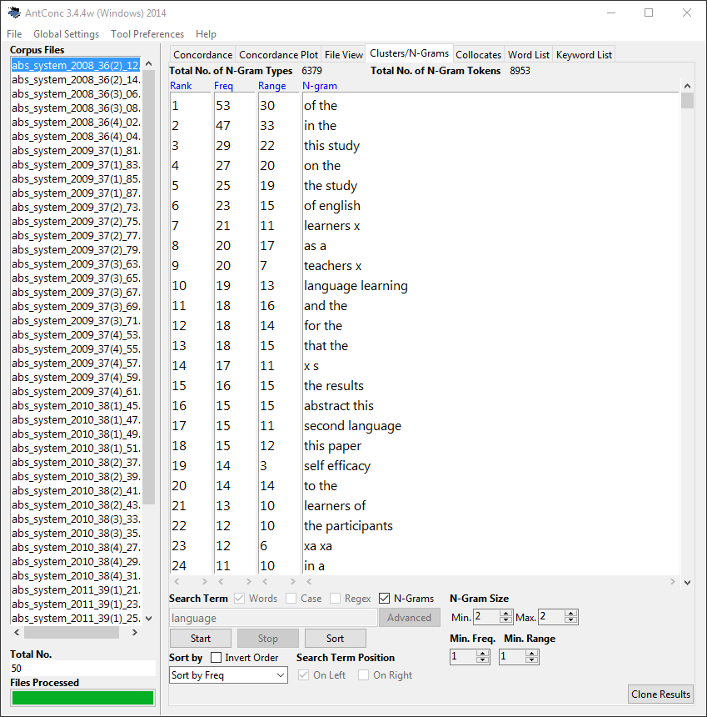

Slide 34
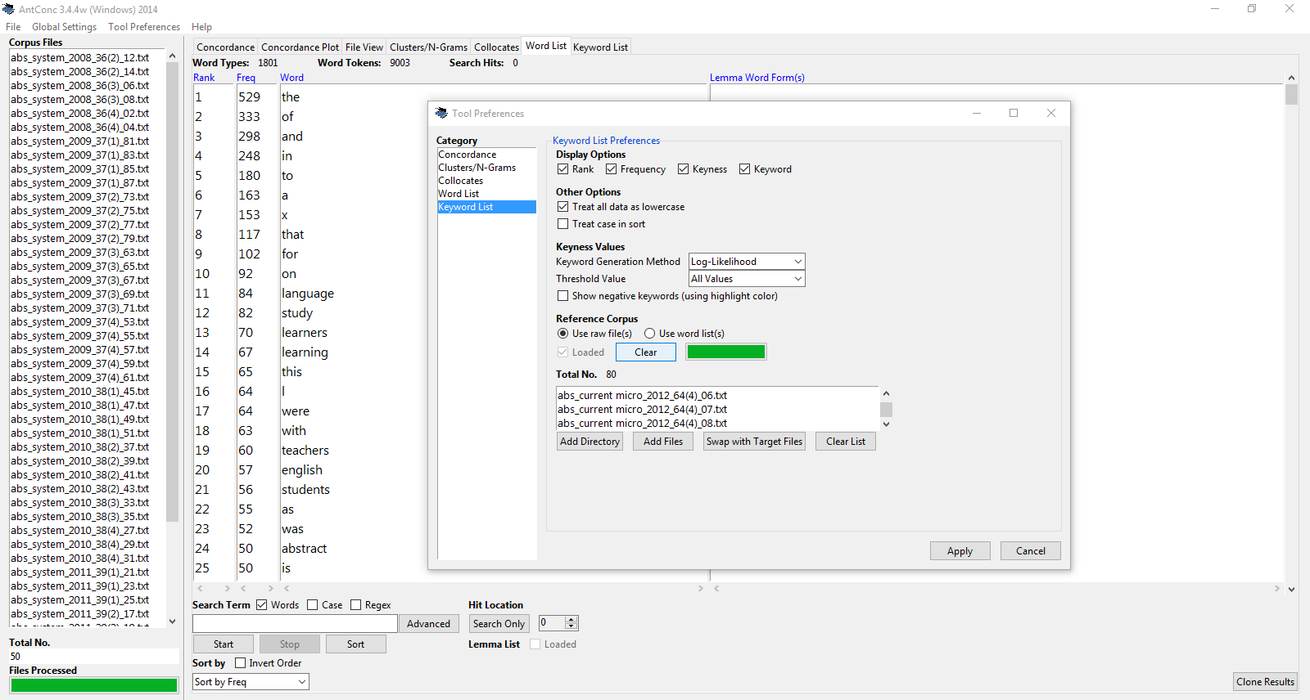
"words which are significantly more frequent in one corpus than another" (Hunston, 2002, p. 68).

Slide 35
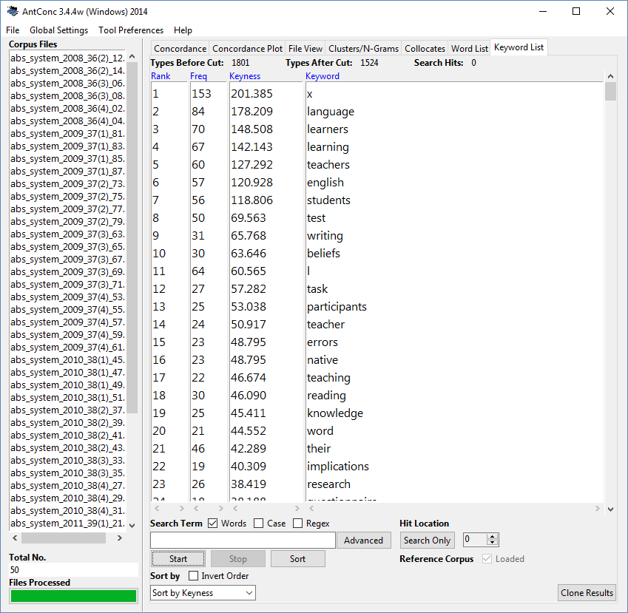
AL vs. Micro
words which are significantly more frequent in Applied Linguistics than Microbiology

Slide 36
Key-BNC
a target corpus vs. BNC
http://crs2.kmutt.ac.th/Key-BNC/

Slide 37
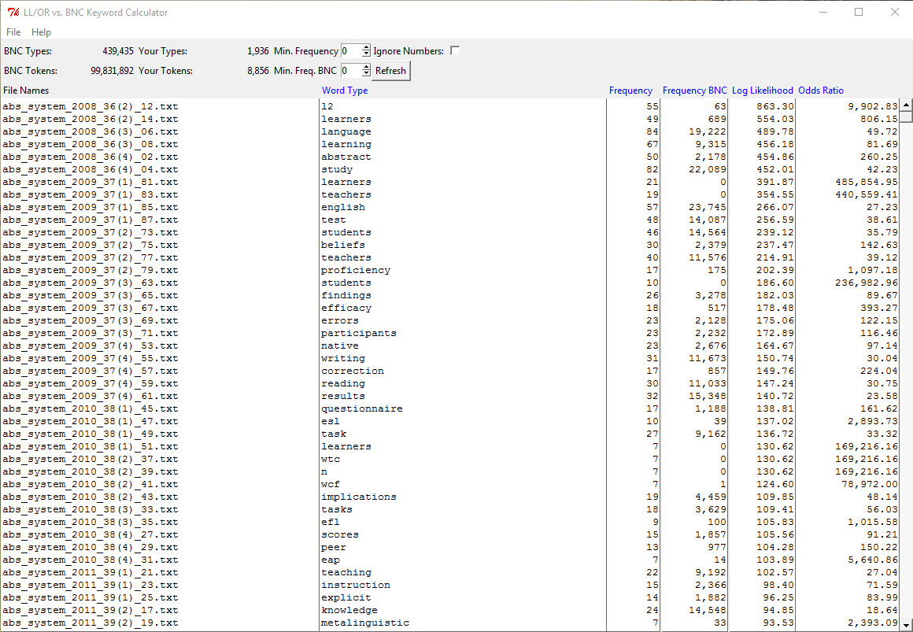
AL vs. BNC
words which are significantly more frequent in Applied Linguistics than general English

Slide 38
TagAnt, CLAWS, USAS
Part II: Corpus analysis tools

Slide 39
Raw vs. Annotated corpora
POS taggers:
TagAnt
CLAWS
Semantic tagger
USAS

Slide 40
Penn Treebank POS Tags Alphabetical list of part-of-speech tags used in the Penn Treebank Project:
e.g. TagAnt

Slide 42
Horizontal
Vertical
This_DT article_NN presents_VVZ a_DT case_NN study_NN of_IN phonological_JJ types_NNS of_IN internal_JJ evaluation_NN in_IN the_DT personal_JJ oral_JJ narrative_NN of_IN one_CD non-native_JJ speaker_NN of_IN English_NP ._SENT
This | DT | this
article | NN | article
presents | VVZ | present
a | DT | a
case | NN | case
study | NN | study
of | IN | of
phonological | JJ | phonological
types | NNS | type
of | IN | of
internal | JJ | internal
evaluation | NN | evaluation
in | IN | in
the | DT | the
personal | JJ | personal
oral | JJ | oral
narrative | NN | narrative
of | IN | of
one | CD | one
non-native | JJ | non-native
speaker | NN | speaker
of | IN | of
English | NP | English
. | SENT | .

Slide 43
UCREL CLAWS7 Tagset

Slide 45
This_DT0 article_NN1 presents_VVZ a_AT0 case_NN1 study_NN1 of_PRF phonological_AJ0 types_NN2 of_PRF internal_AJ0 evaluation_NN1 in_PRP the_AT0 personal_AJ0 oral_AJ0 narrative_NN1 of_PRF one_CRD non-native_AJ0 speaker_NN1 of_PRF English_SENT ._PUN

Slide 46
Semantic tagset
http://ucrel.lancs.ac.uk/usas/USASSemanticTagset.pdf

Slide 47
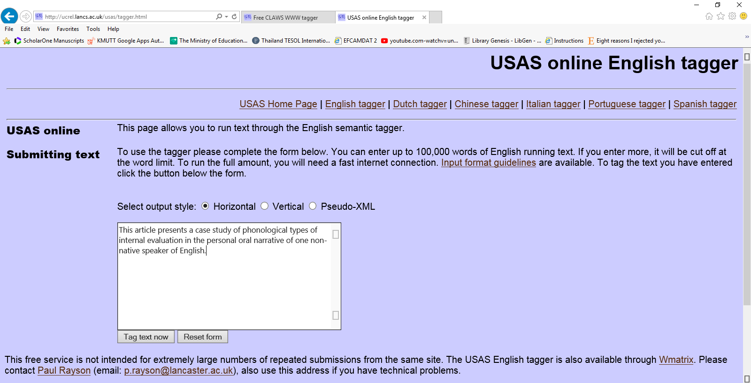

Slide 48
This_M6 article_Q4.2 presents_A9- a_Z5 case_A4.1[i1.2.1 study_A4.1[i1.2.2
of_Z5 phonological_Z99 types_A4.1 of_Z5 internal_M6 evaluation_A5.1 in_Z5
the_Z5 personal_S5- oral_B1 narrative_Q2.1 of_Z5 one_N1
non-native_Q3/S2mf[i2.2.1 speaker_Q3/S2mf[i2.2.2 of_Z5 English_Z1mf ._PUNC

Slide 49
Google Books Ngram Viewer
Part II: Corpus analysis tools

Slide 50
Google Books Ngram Viewer

Slide 51
AntWordProfiler, Range (AWL, GSLs)
Part II: Corpus analysis tools

Slide 54
Part III: Analyzing corpora

Slide 55
Task 1: Exploring COCA
Search COCA by:
Words, e.g. difference, bounce
Phrases, e.g. root and branch, go + adjective
Lemmas, e.g. all form of ‘interest’
Wildcards, e.g. un*ly, im*ment

Slide 57
Task 1: Exploring COCA
Search
draw + noun
would like + to + verb
See
A list of all search results
A chart display
The frequency in the 5 registers
The frequency in subregisters

Slide 58
Task 1: Exploring COCA
Search for collocates
Nouns near ‘discuss’
Adjectives near ‘speak’
Nouns after ‘look into’
Words starting with ‘com*’ near ‘task’
See how words and phrases vary across speech and different types of texts.

Slide 59
Task 1: Exploring COCA
Carry out semantically-based queries
Compare the search results of:
Nouns with occur/happen
Adjective with men/women
Verbs with actor/actress

Slide 60
Task 2: Analyzing a specialized corpus
Corpus: A corpus of research article abstracts (.txt)
Corpus tool: AntConc (http://www.laurenceanthony.net/software/antconc/)
Use different features in AntConc and save output:
Word List
Concordance
Concordance plot
File View
Clusters
Collocates
Keywords
Question: What do you know about a corpus?

Slide 61
Corpora & Corpus tools
COCA, DIY corpus
AntConc, KeyBNC
TagAnt, CLAWS, USAS
Google Books Ngram Viewer
AntWordProfiler
Word frequency lists concordances collocations clusters keywords

Slide 62
References:
Adolphs, S. (2006). Introducing electronic text analysis: A practical guide for language and literacy studies. New York: Routledge.
Bowker, L., & Pearson, J. (2002). Working with specialized language: a practical guide to using corpora. London/ New York: Routledge.
Hunston, S. (2002). Corpora in applied linguistics. Ernst Klett Sprachen.
Scott, M., & Tribble, C. (2006). Textual patterns: Key words and corpus analysis in language education. Amsterdam/Philadelphia: John Benjamins Publishing.
Tognini-Bonelli, E. (2001). Corpus linguistics at work (Vol. 6). John Benjamins Publishing.

