Slide 1
New SoLA structure

Slide 2
Goals of the new SoLA structure
Structure should meet university and faculty goals
Structure should encourage bottom-up input and innovations
Structure should promote interdepartmental cooperation
Structure should be adaptable to match changing contexts

Slide 3
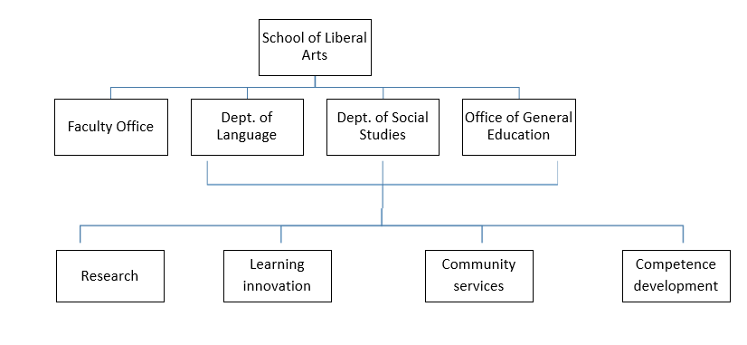

Slide 4
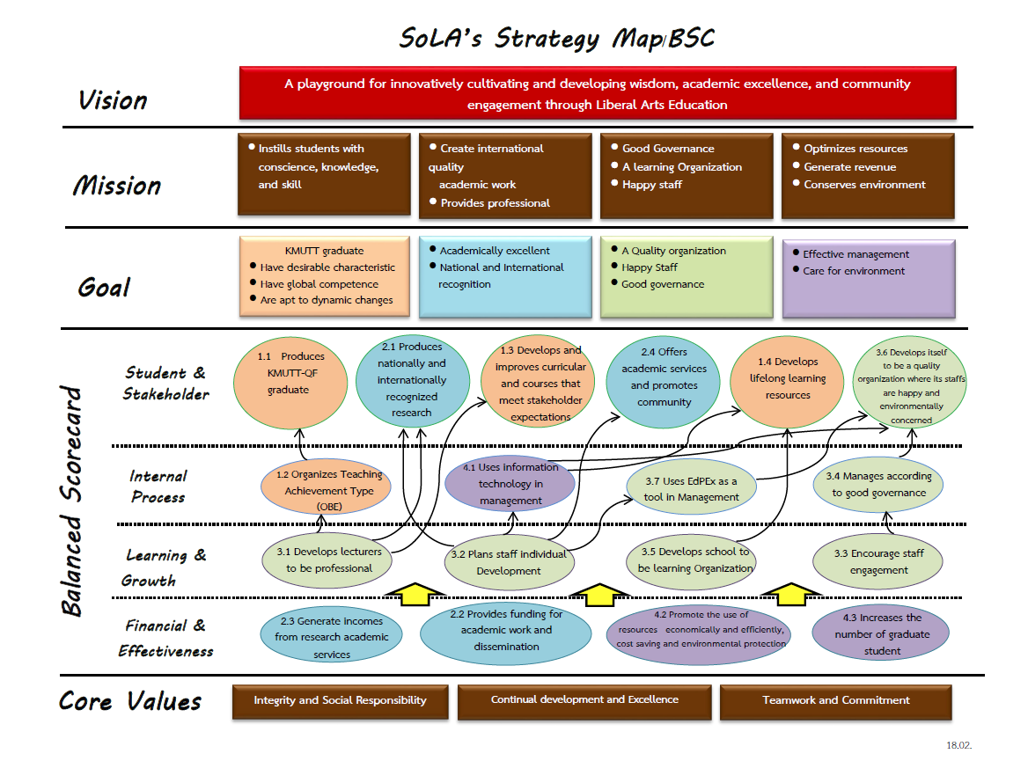

Slide 5
Research: 2.1
Learning innovation: 1.1 and 1.3
Community services: 2.4
Competence development: 1.4
All clusters: 3.6

Slide 6
The 4 functional clusters are the same in Language, Social Studies and General Education:
Research: Research (including postgraduate research programmes) and testing
Learning innovation: Credited courses provided to students from other faculties
Community services: Teaching and services provided to others, especially outsiders
Competence development: SALC, GCDC and student activities

Slide 7
The nature of the clusters
Clusters are informal, unofficial and internal to the Faculty
All staff are employed within a department
All staff still need to fulfill all criteria (5 groups)
Clusters promote innovations and projects
Clusters create a sense of ownership
Clusters promote expertise
Work of clusters funded by other units

Slide 8
Setting up the clusters
Each cluster must include at least one person who is on the Faculty Committee
Each cluster must include at least one person from each department
The research cluster must include at least one person from the committee of each postgraduate programme
Each cluster should have between 10 and 30 members (there are 71 people in total)
All staff choose 2 clusters (Choice 1 and Choice 2) that they would like to work in
Staff will initially be assigned to their Choice 1
Where assignation to Choice 1 does not meet criteria, staff will be asked about their willingness to be assigned to their Choice 2
Choices of clusters can be reviewed every year

Slide 9
How the clusters work
All staff still need to fulfill all criteria
Clusters set goals, make plans and initiate projects
Meeting one Monday afternoon every month

Slide 10
Monday afternoons
 | Aug | Sept | Oct | Nov
First in month |  | 2 | 7 | 4 | Research discussions/clusters; Forums
Second in month |  | 9 |  | 11 | Department meetings
Third in month | 19 | 16 | 21 | 18 | Cluster meetings
Fourth in month | 26 | 23 | 28 | 25 | Other department work (e.g. GSC)
(Fifth in month) |  | 30 |  |  | Forums

Slide 11
How the clusters work
All staff still need to fulfill all criteria
Clusters set goals, make plans and initiate projects
Meeting one Monday afternoon every month
Clusters need to be familiar with relevant university goals, SoLA goals, KPIs etc.
Clusters have a Head – setting agenda, running meetings, facilitating implementation of cluster output
Clusters have a secretary for facilitating meetings
Clusters decide how they will work
Clusters may be bilingual (Suggestion: English as the default written language, Thai – English mixed as spoken language)

Slide 12
Research cluster
Encourage dissemination of SoLA research to wider society e.g. Research blogs
Try Research Powwow as alternative to research mentor programme
Provide funding for SoLA staff to join academic societies
Format 3-credit Masters theses as research articles
Suggest new target groups for promoting TETET

Slide 13
Learning innovation cluster
Suggestions for new courses
Ways of integrating LNG and GenEd courses
New ways of evaluating students
Working on micro-credential courses

Slide 14
Community services cluster
How to run large-scale workplace training like Betagro
Identifying under-resourced schools to help
New sections for the community radio show
Helping villagers monitor pollution
Organising educational trips for Tung Khru children

Slide 15
Competence development cluster
How to design the SALC after it moves
Contacts for organizing exhibitions for GCDC
Ways of encouraging students to use the SALC/GCDC
Working with the Student Union on a student club

Slide 16
The 4 functional clusters are :
Research: Research (including postgraduate research programmes) and testing
Learning innovation: Credited courses provided to students from other faculties
Community services: Teaching and services provided to others, especially outsiders
Competence development: SALC, GCDC and student activities

Slide 17
Research cluster
Language | Social Studies | General Education

Slide 18
Learning innovation cluster
Language | Social Studies | General Education

Slide 19
Community services cluster
Language | Social Studies | General Education

Slide 20
Competence development cluster
Language | Social Studies | General Education

Slide 21
What to do now
Familiarise yourselves with other members of your cluster
Choose a Head for the cluster
Head needs to be familiar with relevant university and faculty goals and KPIs
Head should know how the Faculty works
Prepare for the first meeting (19th August)
Introduce members to relevant university and faculty goals and KPIs
Consider how the cluster will work

