Slide 1
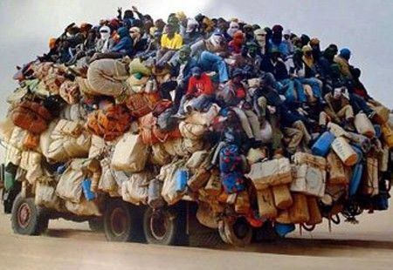
Jumping on the bandwagon or blazing a new trail Designing innovative research
Richard Watson Todd
King Mongkut’s University of Technology Thonburi

Slide 2
Reasons for doing research
Information seekers
Mastery orientation
Driven by curiosity
Conduct research because they want to
Status seekers
Performance orientation
Driven by status
Conduct research because of the rewards
European Commission (2019)

Slide 3
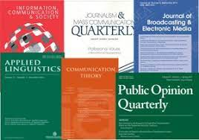
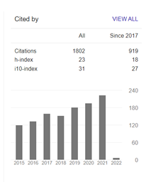
Hopes in research
Publish in a good Q1 journal
Other possibilities
Get noticed
Attract citations
Have an impact

Slide 4
Possibilities with a PhD
Most time/energy for one research study
Support from supervisor
What sort of research
should you do?

Slide 5
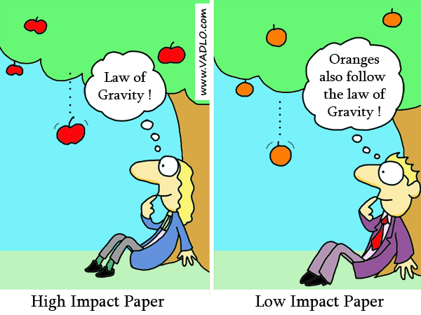
Bandwagon research
The impact of using automated writing feedback in ESL/EFL classroom contexts
The effect of Total Physical Response method on vocabulary learning/teaching: A mixed research synthesis
Chinese EFL university students’ self-reported use of vocabulary learning strategies
Needs assessment of ESL teachers for the integration of computer technology into the teaching and learning of English language in Ekiti state secondary schools
English language learning strategies of pre-service teachers in a Ghanaian college of education
The influence of playing digital game in distance learning towards students’ speaking skill

Slide 6
New trail research 1: Follow the zeitgeist
The Impact of Race on Speech Perception and Accentedness Judgements in Racially Diverse and Non-diverse Groups
Racialized Trajectories to Catalan Higher Education: Language, Anti-Racism and the ‘Politics of Listening’
Co-constructing Social Justice: Language Educators Challenging Colonial Practices in Mexico
Translingual Discrimination: Skilled Transnational Migrants in the Labour Market of Australia
Teachers’ Transnational Identities as Activity: Constructing Mobility Systems at the Intersections of Gender and Language Difference
Translanguaging/trans-semiotizing in teacher-learner interactions on social media: Making learner agency visible and achievable
Look through the list of Advance articles for a top Q1 journal
Are there any trendy topics?

Slide 7
New trail research 2:Timeliness
COVID
Mid-2020 published ‘Teachers’ perceptions of the shift from the classroom to online teaching’ in International Journal of TESOL Studies
Already cited by 32
Post-COVID return to the classroom?
Can you think of how to conduct research into the new post-COVID normal?

Slide 8
New trail research 3: Meaningful gaps
Research aims to fill a gap
Most gaps are not worth filling
Finding a meaningful gap
Case study: How large is a large class?
Writing an encyclopedia article on teaching in large classes
Lots of studies reporting teachers’ beliefs about large classes
No information about what size class actually has an impact on learning
Conducted analysis of 35,000 course grades by class size
Thresholds at 25 and 45 students/class

Slide 9
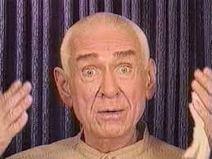
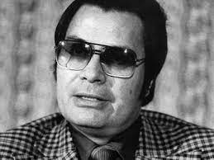
New trail research 4: Intrinsic interest
Find a topic of intrinsic interest
Case study: The language of destructive cults
Can the potential dangers of a cult be identified from the sermons of the cult leader?

Slide 10
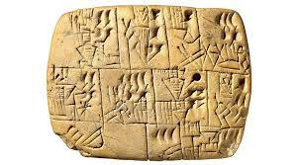
New trail research 5: Unusual data
Find some unusual but interesting data that no-one has thought of investigating
Case study: Business communication in ancient Sumeria
Comparing the generic structure of business communication of modern business letters and Sumerian cuneiform tablets
Think of intrinsically interesting topics or unusual data that could be the focus of applied linguistics research

Slide 11
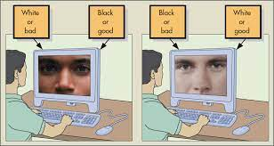
New trail research 6: Unusual instruments
Find a data collection instrument (probably from another discipline) that has potential but has not been used in applied linguistics
Case study: Implicit Association Test
Lots of surveys of students’ beliefs about native and non-native speaker teachers
Problems of truthful data in studies concerning prejudice
Used the IAT (from social psychology) to investigate explicit and implicit attitudes towards native and non-native speaker teachers

Slide 12
New trail research 7: Borrowing theories
Borrow theories from other disciplines
Psychology as a key source discipline
Dörnyei’s possible selves theory of motivation
Case study: Gratitude
Colleague with a background in affective factors in learning was looking for a new topic
Suggested he draw from psychology
Worked on the construct of gratitude in language teaching

Slide 13
New trail research 8: Unusual analysis
Expectations about how data should be analysed change
Statistical analysis in applied linguistics
1970s Descriptive statistics sufficient
1980s-2000s Inferential statistics using p-values (probability statistics)
2010s Inferential statistics using both probability statistics and effect sizes
2020s Move towards Bayesian probability statistics with effect sizes?
Unusual analyses specific to certain approaches
Contradictions in teachers’ classroom dynamic assessment implementation: An activity system analysis
The role of membership viewpoints in shaping language teacher associations: A Q methodology analysis

Slide 14
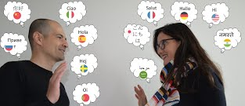
New trail research 9: Creating new theory
Research highlights a construct or direction never previously discussed
Case study: Everyday communication in Anglophone Cameroon
Multilingual environment where interlocutors mix languages in predictable ways
Previous work: code-switching, code-mixing, translanguaging
Data suggests mid-point between code-mixing and translanguaging
Created construct of mixed-languaging

Slide 15
Difficulties with narrow-minded reviewers
Greater amount that needs to be explained
Difficulties with writing arguments in new areas
Possibility of being too ahead of the curve
Use of chatbots for language learning in 1999

